Slide 1
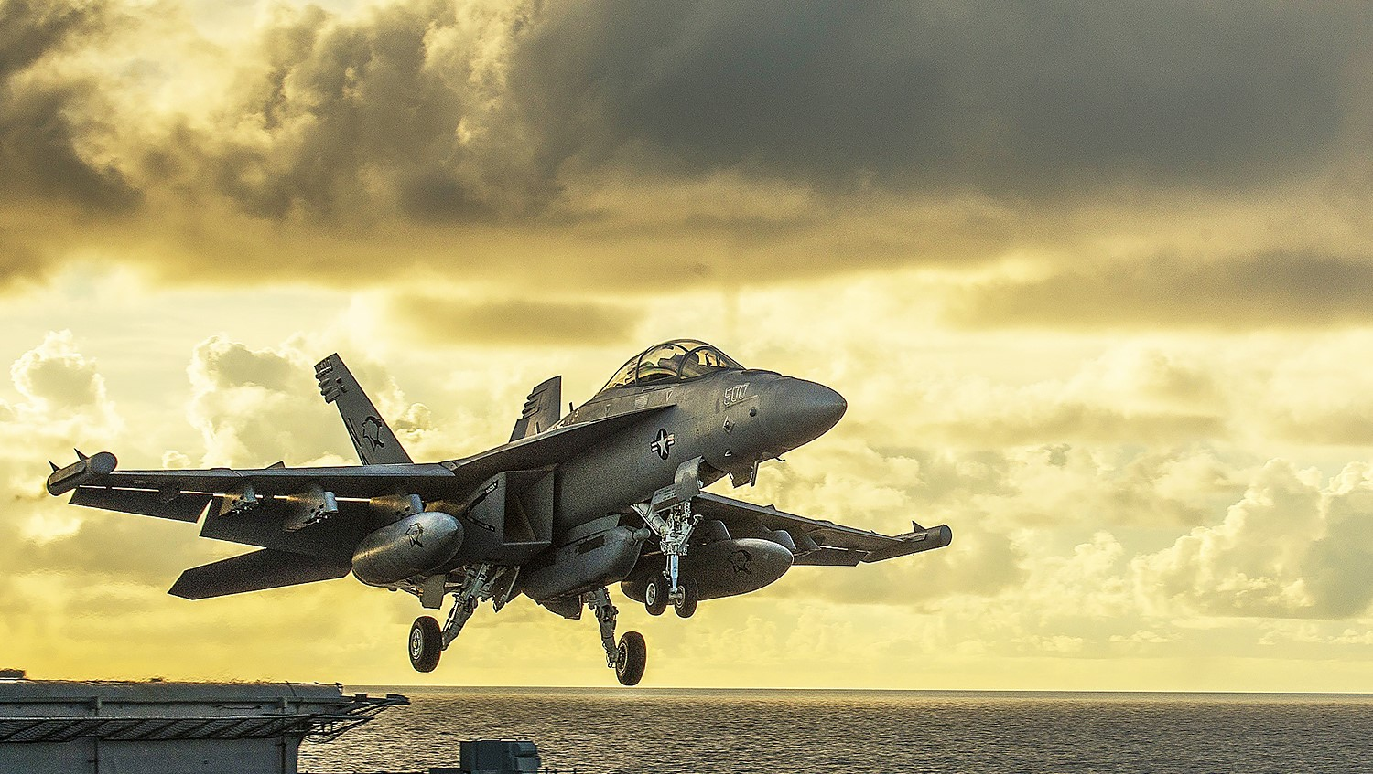



Arms Race

Slide 2
What does cross your mind when you hear the term “Arms race” ?

Slide 3
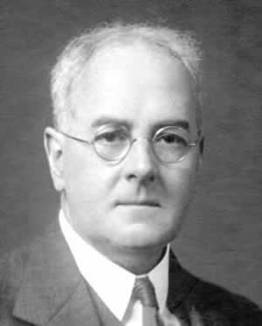
Who is Lewis Richardson ?!
Richardson was born in 1881, was an English scientist and the pioneer in mathematical techniques and its relation in wars .
He designed a system to analyze and predict wars between nations. That was later called the "Richardson's Arms Race Model ".

Slide 4
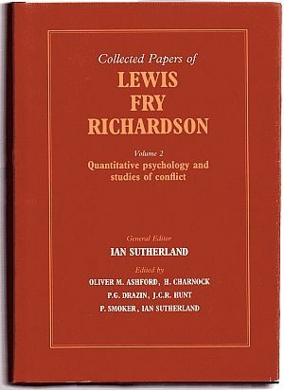
Richardson's Model of Arms race
According to Richardson the conflict between two nations can be determined and analyzed by a set of differential equations.
These equations state the probability of any nation in entering a war and it depends on many factors.

Slide 5
Ammo Build up
Language and color
Religion and Ideology
Factors that lead to an arms race.
Economic development
Culture

Slide 6
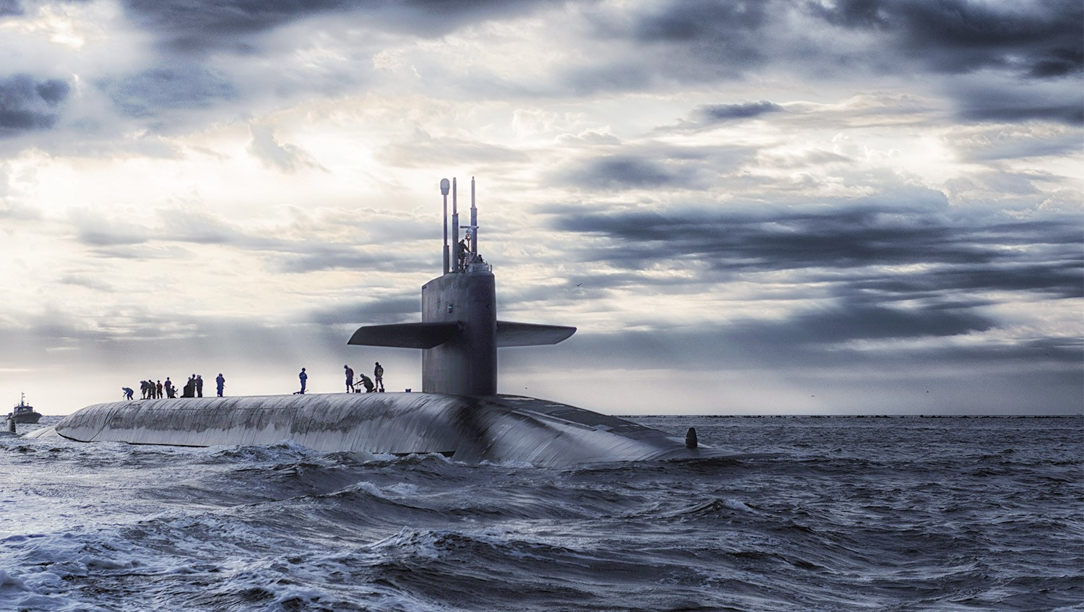
The model analysis

Slide 7
Richardson concluded that the state of any conflict between any two nations can be summed up in three cases only.

Slide 8

The equilibrium case
Here in this case we simulate the situation in which every possible conditions that could lead the two nations into equilibrium point is achieved.

Slide 9

The runaway race case
In this case the two nations are sufficiently hostile to each other - don't need more reasons to start a war so they will simply enter a runaway arms race direct .

Slide 10

The Friendly case
As in this case the two nations are have enough reasons and common benefits to stay friendly towards each other so they will never enter an arms race.

Slide 11
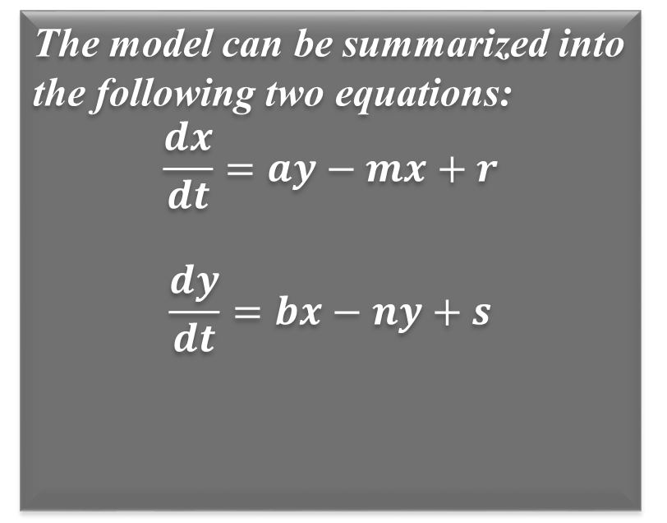
Richardson’s Equations
The model can be summarized into the following two equations:
$$\frac{dx}{dt}=ay−mx+r$$
$$\frac{dy}{dt}=bx−ny+s$$
Where:
x,y = Armament level of the country.
a,b = Defense coefficients.
m,n = Fatigue coefficients.
r,s = The hostility / peace terms.

Slide 12
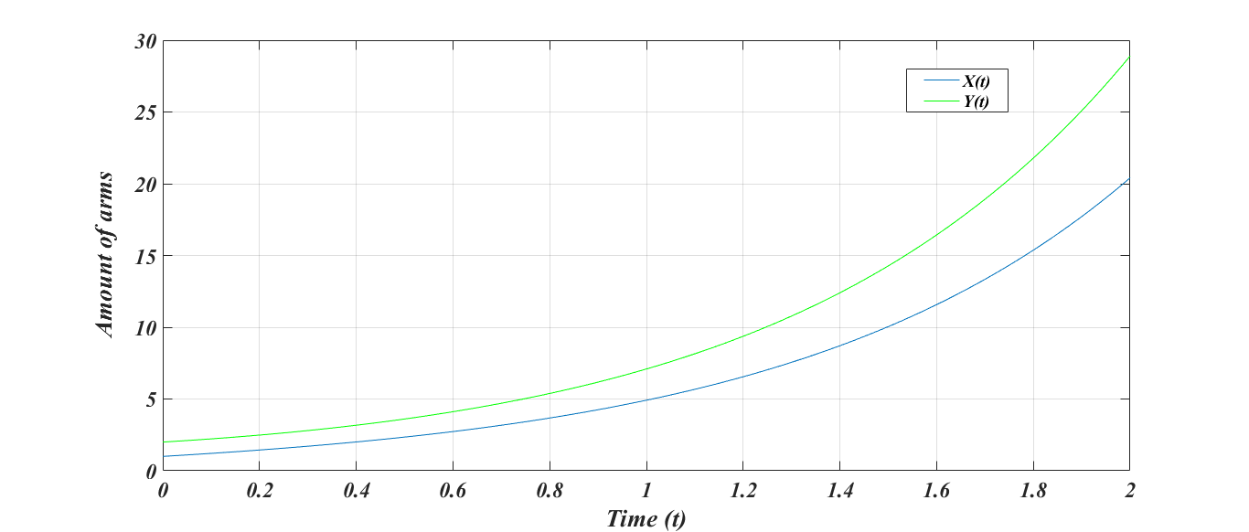
Equations Modeling

Slide 13
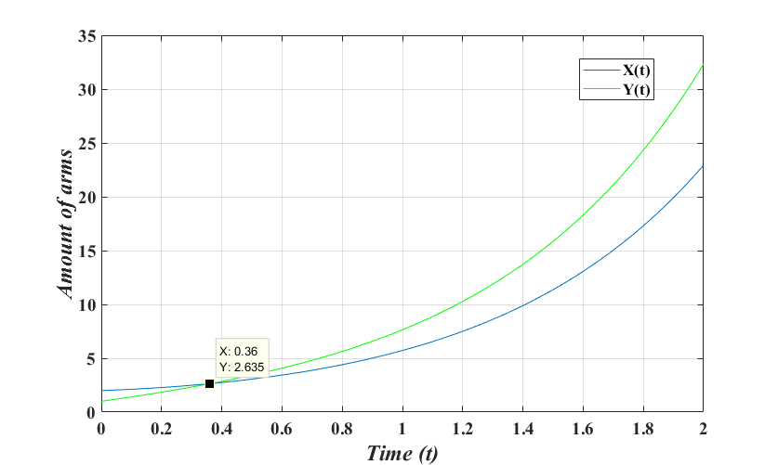
Equations Modeling

Slide 14

Richardson’s Flaw
The problem with the model is that Richardson didn't mention the budget constraint and doing so caused a great divert in the results causing many errors.
Also: if the hostility/peace terms are -ve and other coefficients = 0, then it will give corrupted results.

Slide 15
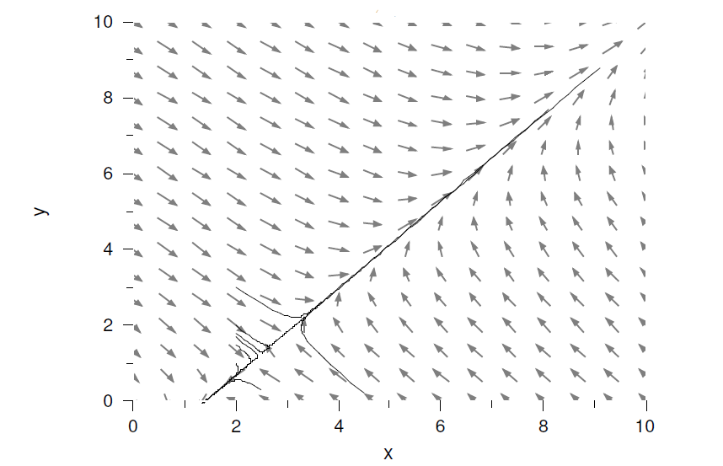
Richardson’s Results

Slide 16
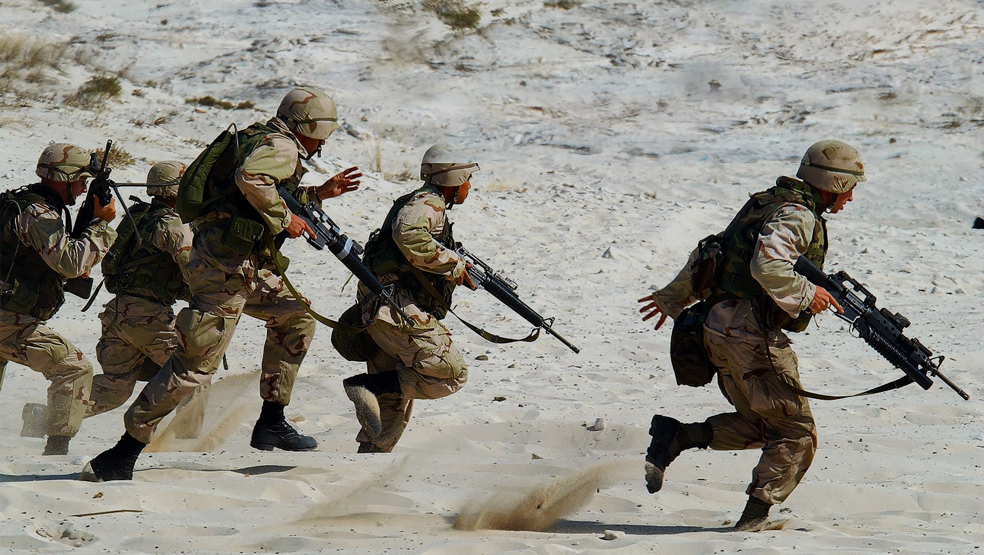
A new Model and Applications

Slide 17

Suggested model
In order to overcome the fault Richardson did, we had to work more on the model mathematically taking into consideration the variables Richardson missed.

Slide 18
In order to solve the problem of budget and the missed results we will use max. and min. theories to construct terms that will help in achieving the new model.

Slide 19
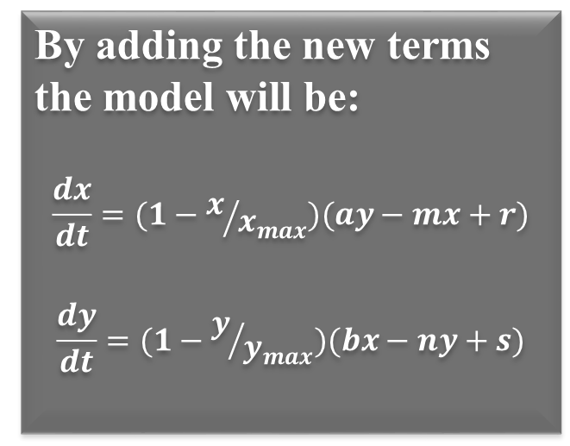
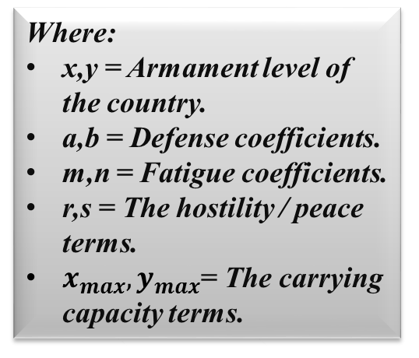
The new model’s equations
By adding the new terms the model will be:
$$\frac{dx}{dt}=(1−x/{x_{max}})(ay−mx+r)$$
$$\frac{dy}{dt}=(1−y/{y_{max}})(bx−ny+s)$$
Where:
x,y = Armament level of the country.
a,b = Defense coefficients.
m,n = Fatigue coefficients.
r,s = The hostility / peace terms.
$x_{max}, y_{max}$= The carrying capacity terms.

Slide 20
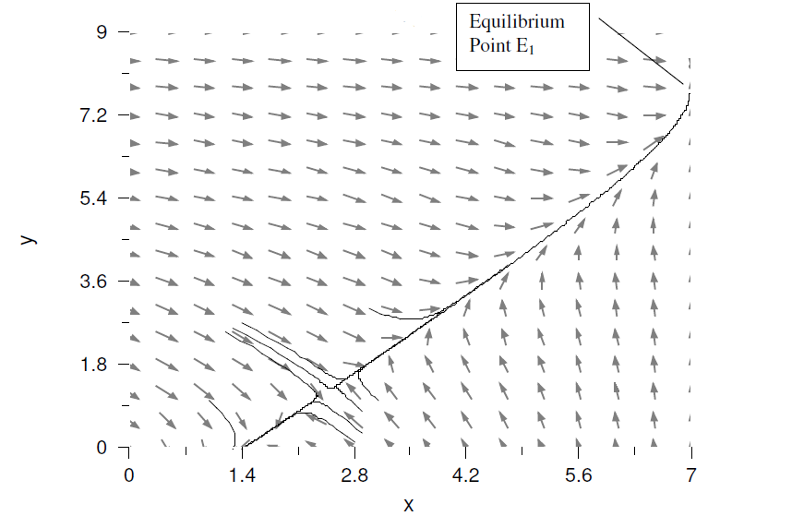
The new model’s Results

Slide 21
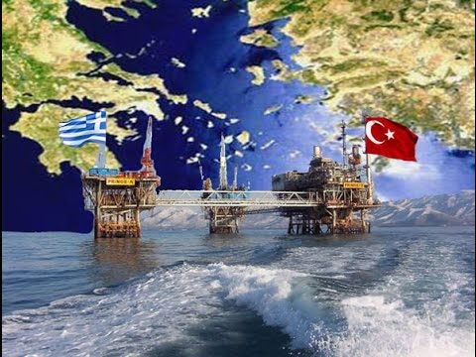
Applications on arms race
Scientists applied the classical Richardson model for the (Greece -Turkey Conflict) over the periods 1950-1986.
But his results were very poor to proof theory of arms race.

Slide 22
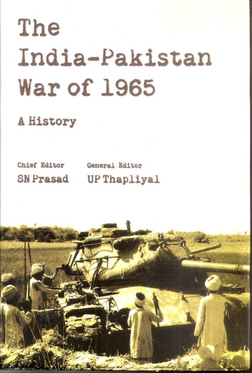
Applications on arms race
Unlike Greece and Turkey where the literature is ambiguous.
previous studies of (Indian – Pakistani Conflict) have found evidence of a Richardson type arms race in the sub-continent.

Slide 23
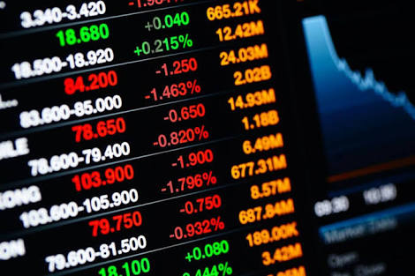
Applications on arms race
The environment in which firms operate today is highly competitive and quite similar to that of a military conflict.
So we use arms race to analyze and predict the market condition.

Slide 24

Thanks for listening.
Any Questions ?!

